Slide 1
LET’S TALK ABOUT REPORT WRITING!
LAKSHMI BANNER

Slide 2
A report is a formal document
Use formal language and short sentences
Refer to your research and findings
Use headings and bullet points if it makes your report clearer.
Notes:
Blue
Get a discussion going

Slide 3
Which example uses Formal language?
Example A
From the pie chart it is clear that the majority of students do not drop litter, with only five respondents saying they often do. Over 80% either never or only sometimes drop litter
Example B
If you look at the pie chart I drew you can see that not many students drop litter often, and loads of students don’t drop litter at all.
Notes:
Refer to your graph. Use statistics and figures. Use formal language.

Slide 4
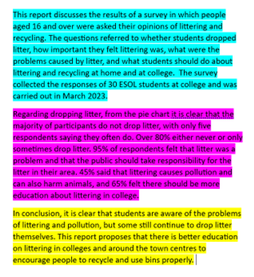
A report has a structure
Have an opening paragraph which outlines the purpose of the report
Include a paragraph discussing your findings
Include a conclusion to discuss your findings
Notes:
Blue
Get a discussion going

Slide 5
Put the following into the right order
A. The graphs show that over 80% of students do not usually litter.
B. In conclusion, it is clear that students take the issue of littering very seriously.
C. The purpose of my report is to find out what students think about litter and recycling.

Slide 6
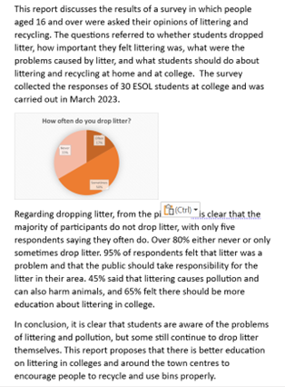
Introduce your report
What is the purpose of your report?
Explain who took part in the survey
Explain why you asked the questions

Slide 7
Discuss your findings
Use appropriate graphs and charts
Be specific – refer to percentages and figures
Compare your results - which answers came out top?

Slide 8
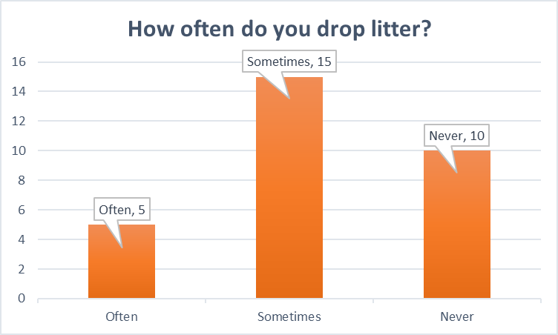
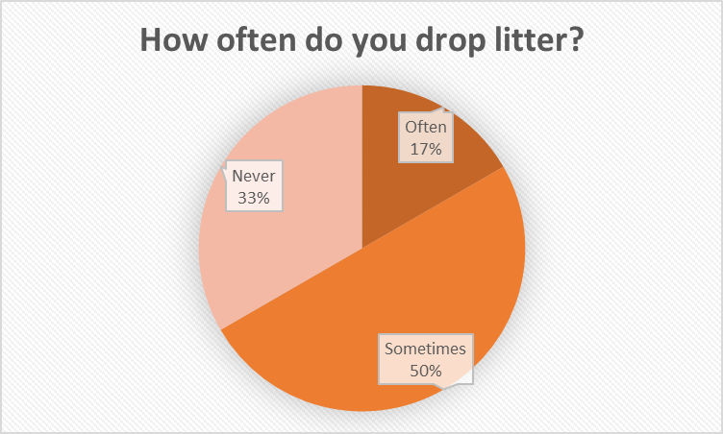
Which is the best graph for this question?
Notes:
All kinds of topic
Learn about your topic – subject knowledge

Slide 9
Conclusion: say something interesting!
What were your findings?
Did they surprise you?
Can you see any trends? For example, are answers different depending on gender (male/female) or age?
What have you learnt?

Slide 10
In conclusion: What is a report?
A formal document that discusses a topic using facts, charts, and graphs to support your findings.
Uses charts and graphs to visually show your findings.
Ends with strong conclusions – make a statement!
Should both inform and be interesting to your reader.
Notes:
Online journal, tell your story – lots of 'I'
Educate others
Get a discussion going

Slide 11
Further Reading
Writing about survey results
https://learnenglishteens.britishcouncil.org/skills/writing/upper-intermediate-b2/writing-about-survey-results
Comparing results
https://learnenglish.britishcouncil.org/skills/writing/upper-intermediate-b2/comparing-two-charts

